Slide 1
Enhancing the application of Geosynthetics
www.garwarefibres.com

Slide 2
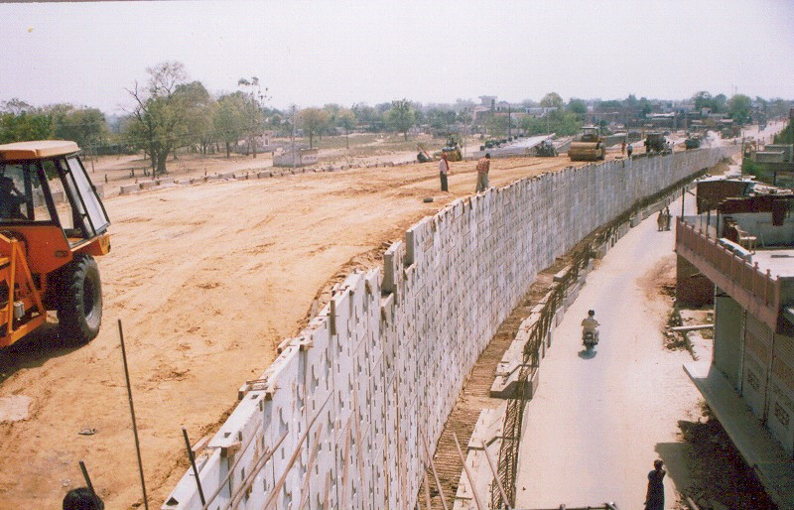
Commonly used applications of geo-synthetics

Slide 3
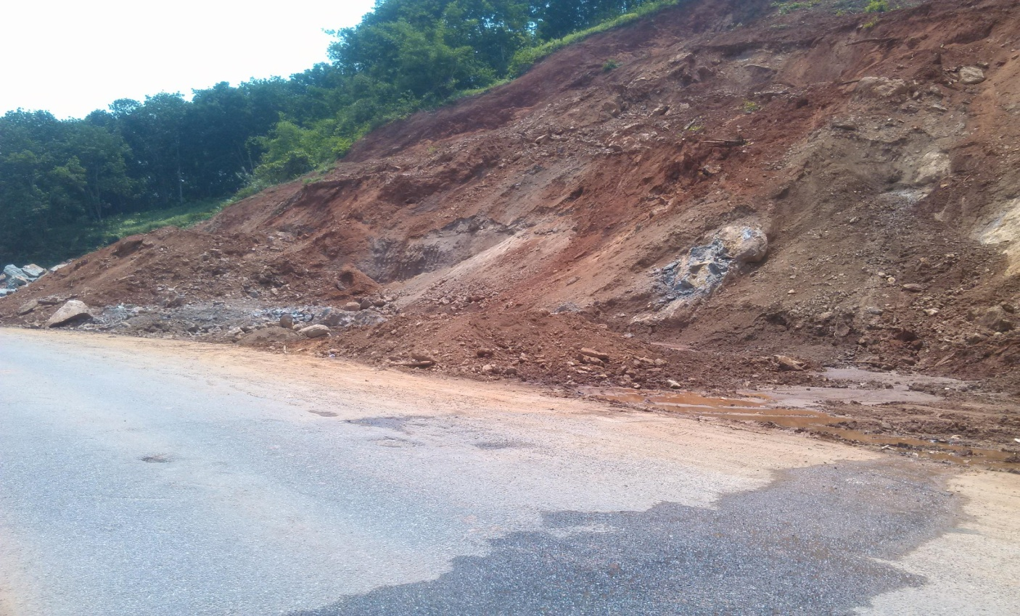
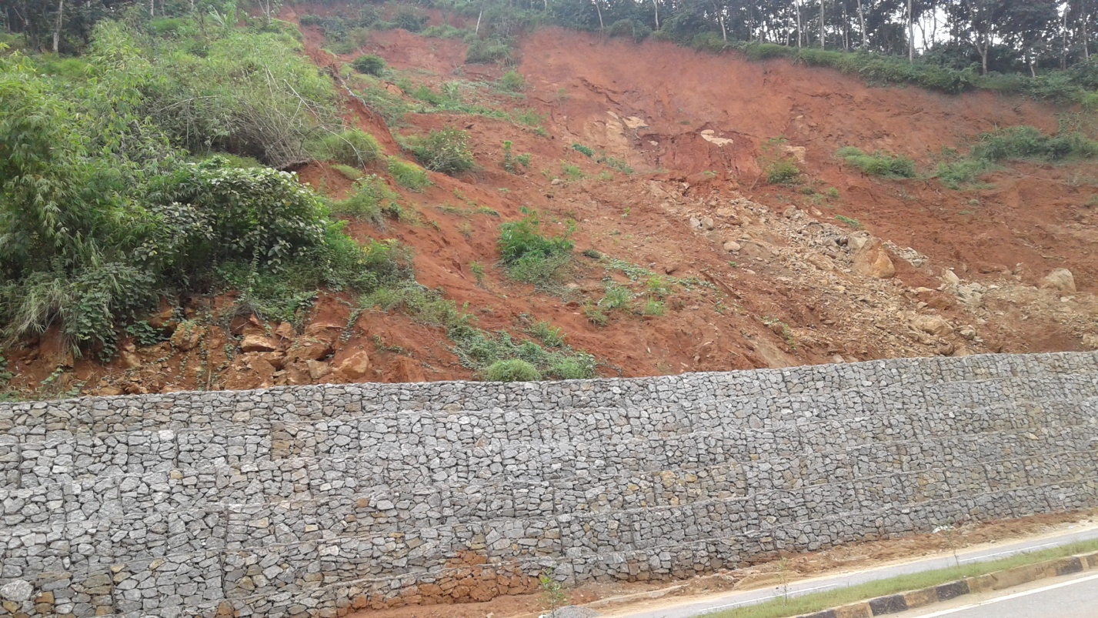
Commonly used applications of geosynthetics
Photograph of the site before intervention
Photograph of the site after intervention

Slide 4
What was done right ?
Extensive trials and R&D to establish viability of the system
Life cycle costing considered for viability
Incorporation into standards ( MoRTH, IS codes, IRC codes, etc )
Mandate to user agencies / Consultants

Slide 5
The road forward
River applications
Coastal applications
Other highway applications
Mining applications
Smart cities

Slide 6
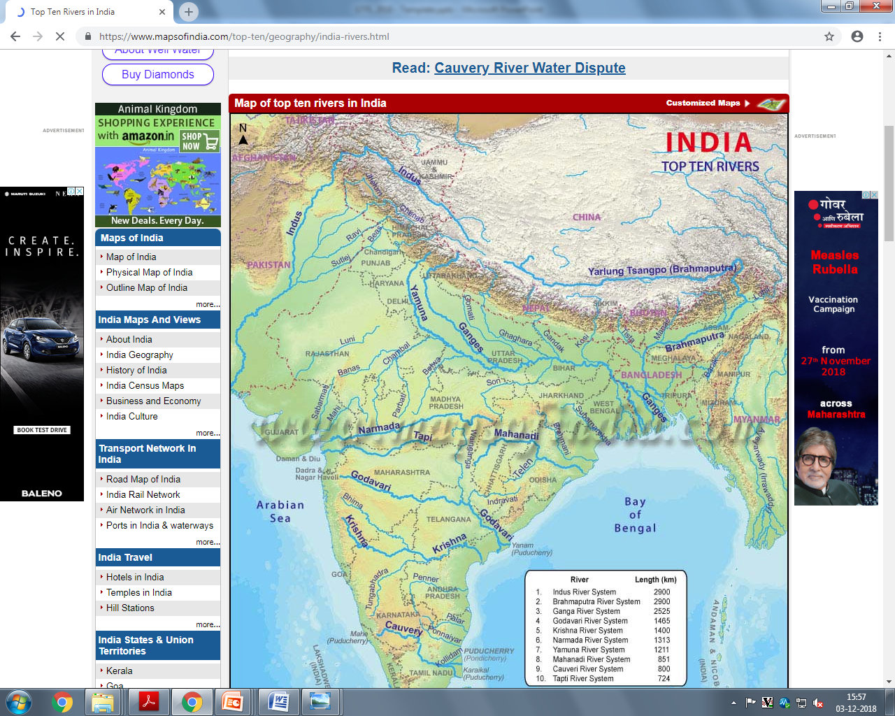
MAJOR RIVERS IN INDIA

Slide 7
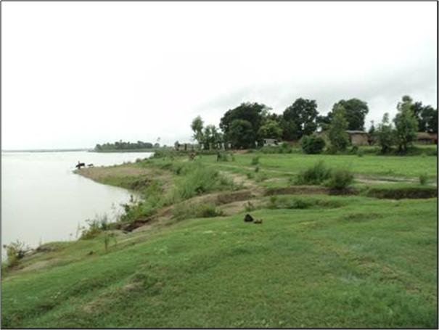
AGRICULTURAL LAND ENCROACHMENT BY RIVERS

Slide 8
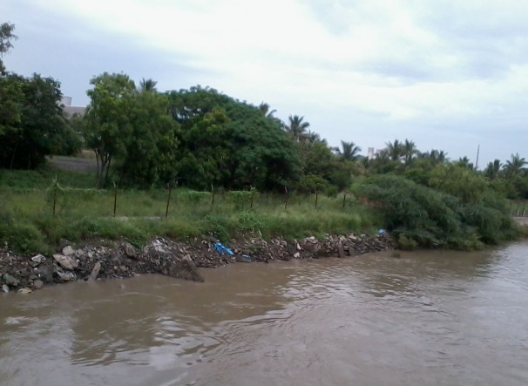
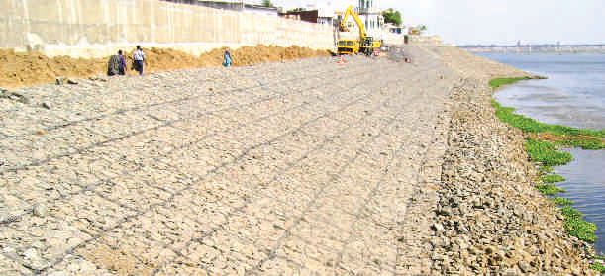

Slide 9
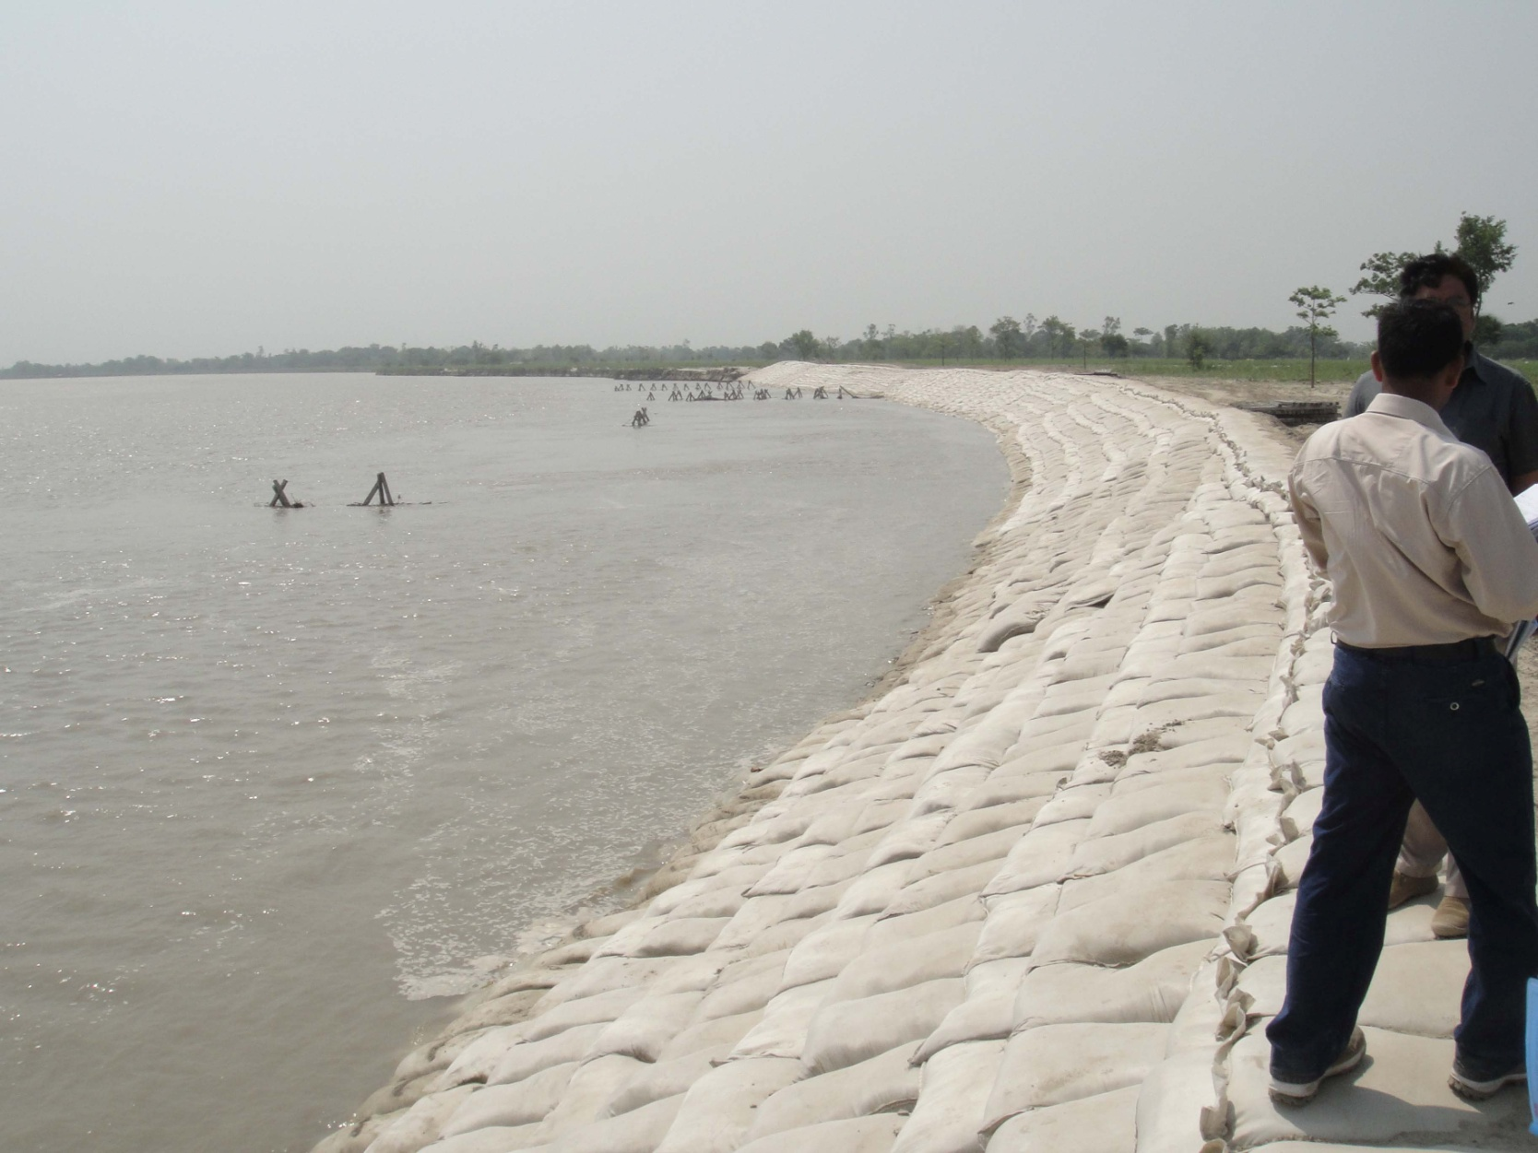
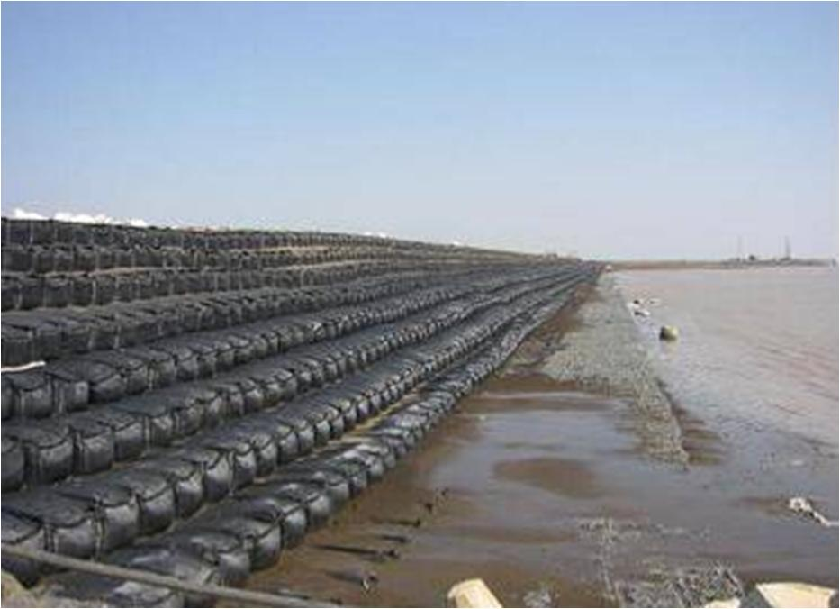

Slide 10
India :
Total Coast Line, 8413 km
Accretion – 3004 km
Erosion – 3829 km
Stable – 1580 km
Natural Forces :
Tidal level variation
Cyclones
Storms`

Slide 11
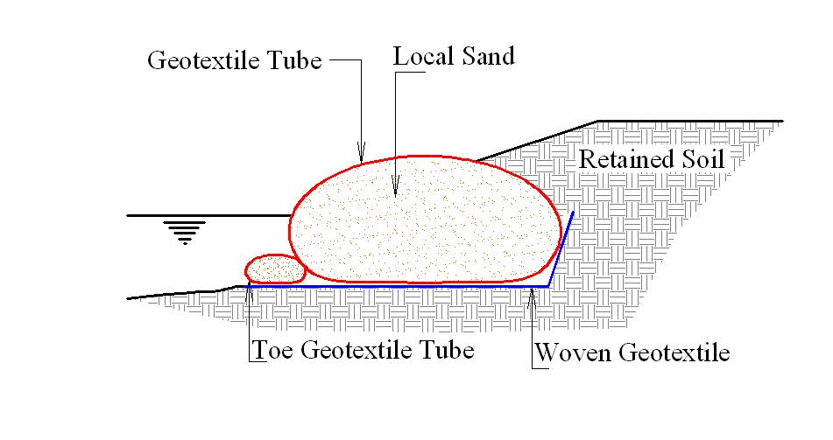
REVETMENTS

Slide 12
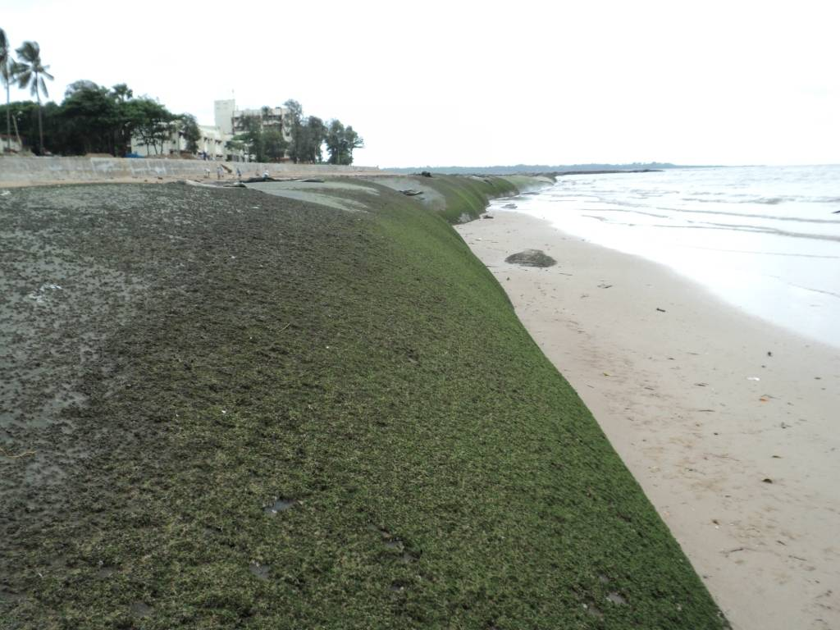
COASTAL REVETMENTS

Slide 13
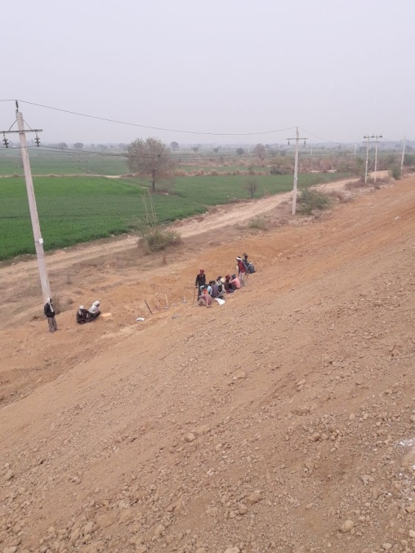
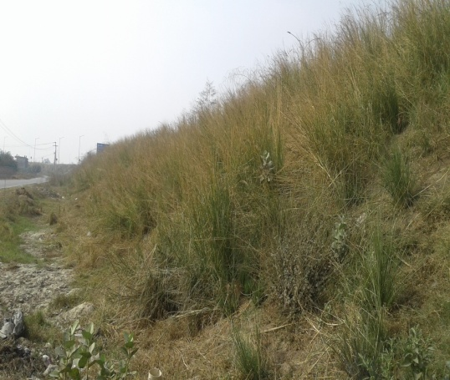
OTHER HIGHWAY APPLICATIONS – EROSION CONTROL

Slide 14
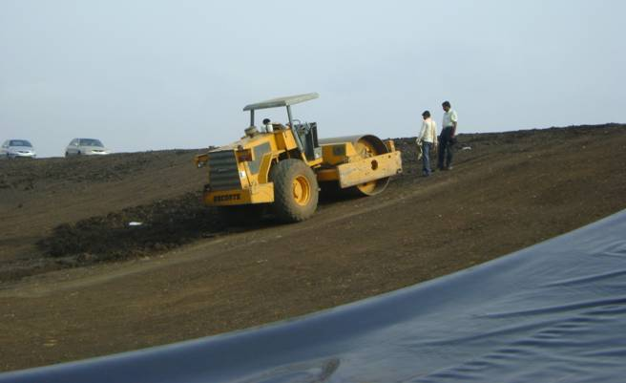
SMART CITIES – LANDFILLS FOR SOLID WASTE MANAGEMENT

Slide 15
Challenges ?
Lack of a “preventive maintenance culture”, especially in the Water Resource Departments
Life cycle costing not considered for viability.
Lack of standards, codes, guidelines
Need for a central co-ordination agency to pull the diverse experiences of State Governments and imbibe learnings
Delays in decision making
Lack of a clear cut mandate from the decision making level

Slide 16
Thank you
www.garwarefibres.com

